Slide 1

AMONEY
Spiritual Heritage Vault
Bridging Heritage
Preservation with
Web3 Innovation
The world's first blockchain infrastructure dedicated to preserving and transmitting spiritual digital assets across generations
99B+
$140B
20%
Ethereum • Polygon • Sui
Token Supply
Market Gap
Bitcoin Lost
Multi-Chain Infrastructure

Slide 2
NAVIGATION
Executive Overview
01
Project Vision & Market Opportunity
05
Technical Implementation
Revolutionary blockchain infrastructure addressing the $140B digital inheritance crisis
Multi-chain architecture with institutional-grade security and decentralized storage
02
Spiritual Heritage Vault Architecture
06
Market Strategy & Business Model
Sacred custody model with multi-generational inheritance protocols
Four-phase go-to-market with diverse revenue streams and strategic partnerships
03
NFT Ecosystem & Minting Infrastructure
07
Risk Assessment & Mitigation
Comprehensive infrastructure with Layer 2 optimization and AI authentication
Comprehensive risk management across technical, market, and operational dimensions
04
Token Economic Model
08
Development Roadmap
Sustainable 99B tokenomics with deflationary mechanisms and multi-chain utility
Strategic timeline from 2026 foundation to 2028+ global spiritual asset registry

Slide 3
EXECUTIVE SUMMARY
A New Paradigm in Digital Heritage
Core Innovation
Key Metrics
AMONEY introduces the world's first comprehensive blockchain infrastructure dedicated to Spiritual Digital Assets (SDAs) . The Spiritual Heritage Vault transcends traditional cold storage by implementing sacred custody models derived from legal trust frameworks and spiritual stewardship principles.
$140B
Market Gap in Digital Inheritance
Bitcoin alone inaccessible
20%
Market Opportunity
Bitcoin Permanently Lost
The platform addresses the critical reality that approximately $140 billion in Bitcoin alone remains inaccessible due to lost private keys, while extending solutions to encompass prayers, teachings, artistic expressions, and community connections that define human cultural identity.
Due to lost keys
99B+
AMONEY Token Supply
Multi-chain deployment
Sacred Custody
AI Authentication
Conditional logic with multi-generational inheritance protocols
Computer vision and NLP for content verification and classification
Technical Foundation
ERC-721/ERC-1155 NFT standards
Layer 2 scaling (Polygon, Arbitrum)
Cross-chain bridges (Sui integration)
MiCA regulatory compliance

Slide 4
PROJECT BACKGROUND
The Genesis of Digital Heritage Preservation
$30B
20%
60-70%
Annual Market Gap
Bitcoin Supply Lost
Cost Reduction
Religious organizations spend 15-20% of budgets on inadequate digital preservation solutions
Permanently inaccessible due to deceased holders without succession plans
Estimated estate settlement cost reduction with smart contract automation
Evolution of Digital Preservation
Core Philosophy
Traditional Physical Vaults
"Unlike previous digital preservation attempts that relied on institutional continuity, AMONEY's decentralized architecture ensures that spiritual assets persist as long as the underlying blockchain network operates, theoretically extending preservation timelines from decades to centuries."
1
Physical storage with institutional dependency and limited accessibility
2
Cloud-Based Storage
Centralized digital solutions vulnerable to institutional failure
AMONEY Whitepaper
3
Blockchain Spiritual Repositories
AMONEY's innovation: Decentralized architecture ensuring spiritual assets persist as long as blockchain operates
Decades → Centuries
100% Immutable
Extended Preservation
Blockchain Security

Slide 5

CORE ARCHITECTURE
Spiritual Heritage Vault: Sacred Custody System
Preservation
Transmission
Activation
IPFS and Arweave decentralized storage ensuring eternal accessibility of spiritual content with cryptographic verification
Smart contract-based inheritance protocols with conditional logic and oracle verification for multi-generational transfer
Dynamic NFT ecosystems generating yield, community access, and DeFi collateral utility beyond static storage
Content-addressed retrieval
Conditional access rights
Yield-generating mechanisms
Cryptographic verification
Oracle death verification
Community access rights
Perpetual storage backup
Multi-generational protocols
DeFi collateral (30-60% LTV)
Sacred Custody Model Features
Multi-Generational Value Transfer
Legal Trust Framework
Spiritual Stewardship
1
Asset Tokenization
Derived from established trust law principles
Sacred principles for asset management
Spiritual artifacts converted to NFTs with provenance
2
Vault Configuration
Conditional Logic
Fractional Ownership
Inheritance rules and beneficiary designation
Time-based and event-triggered access
Shared custody of sacred artifacts
3
Automated Transfer
Smart contract execution upon verified events

Slide 6
NFT ECOSYSTEM
Comprehensive Minting & Issuance Infrastructure
Minting Infrastructure
Issuance Models
Lazy Minting
Gasless
Primary Market
Airdrop Campaigns
No upfront gas costs until first purchase, ideal for spiritual communities with limited resources
• Initial DEX Offerings (IDO)
• Soulbound Airdrops
• Dutch Auction Mechanisms
• Mystery Box Discovery
• Community Fair Allocation
• Staking Reward Multipliers
Traditional Minting
Immediate
VIP Tier System
Immediate on-chain permanence for high-value spiritual artifacts requiring instant verification
Silver
Gold
Platinum
1,000 AMONEY
10,000 AMONEY
100,000 AMONEY
Layer 2 Integration
95% Savings
Polygon and Arbitrum reducing gas costs by up to 95% while maintaining institutional-grade security
AI-Powered Authentication
1
Asset Submission
Digital files with provenance documentation and spiritual significance
Gas Fee Optimization
2
AI Analysis
Computer vision and NLP for authentication, valuation, classification
Ethereum Mainnet
$5-50
3
Curator Review
Maximum security
per transaction
DAO governance ensuring cultural sensitivity and spiritual authenticity
Asset Classification Dimensions
Polygon PoS
<$0.01
Religious Tradition
Sacredness Level
Temporal Sensitivity
Relational Context
High throughput
per transaction
Sui Network
~$0.001
Ultra-low cost
per transaction

Slide 7
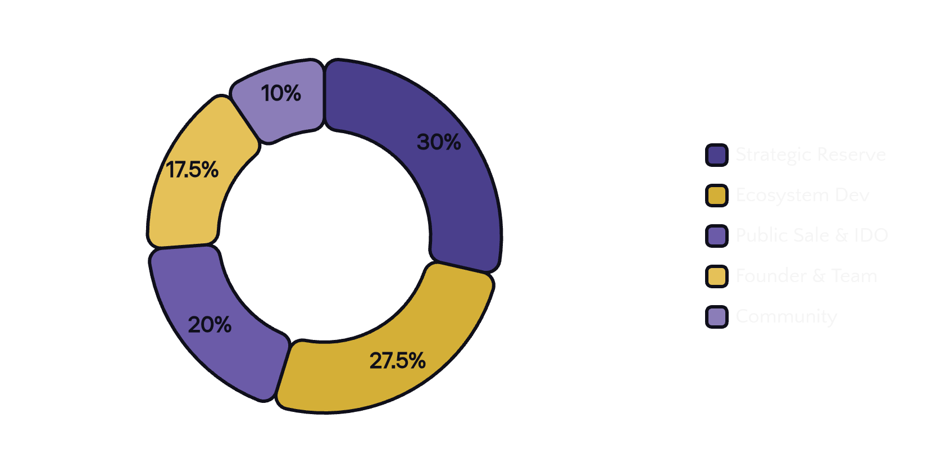
TOKENOMICS
Sustainable Token Economic Model
Total Supply
Token Standard
Decimal Places
Primary Chains
99.9B
ERC-20
9
ETH • MATIC • SUI
AMONEY Tokens
Ethereum Compatible
Precision
Multi-Chain
Deflationary Mechanisms
Token Allocation Strategy
Transaction Burn
0.5%
Of every transaction permanently removed from circulation
Minting Fee Burn
30-50%
Percentage of NFT minting fees burned
Vault Maintenance Burn
40%
Of annual vault maintenance fees
Vesting Schedules
Team & Founders
Cliff Period
Linear Vesting
24 mo
36 mo
Core Utilities
Community Rewards
Minting Fee Payment
Vault Activation
Distribution
Bonus
24-48 mo
Active
Governance Voting
Staking Rewards

Slide 8

TECHNICAL FOUNDATION
Multi-Chain Infrastructure with Institutional Security
Multi-Chain Architecture Strategy
Ethereum
Polygon
Arbitrum
Sui
Use Case:
High-value vaults
Use Case:
Community NFTs
Use Case:
DeFi integration
Use Case:
High-frequency
Gas:
$5-50
Gas:
<$0.01
Gas:
~$0.50
Gas:
~$0.001
TPS:
15-30
TPS:
7,000+
TPS:
40,000
TPS:
100K+
Security:
Maximum
Security:
High
Security:
High
Security:
Institutional
Smart Contract Security
Storage Integration
Formal Verification
IPFS Primary Storage
Mathematical proofs ensuring contract correctness
Content-addressed retrieval with cryptographic verification
Multi-Signature
Arweave Permanent Backup
Requiring multiple approvals for critical operations
Immutable, perpetual storage for generational preservation
Comprehensive Audits
Encryption Standards
Third-party security assessments by leading firms
AES-256 encryption with decentralized key management

Slide 9
GO-TO-MARKET
Strategic Market Approach & Business Model
High-Net-Worth
Religious Communities
Digital Art Collectors
DeFi Power Users
Wealth preservation and tax-efficient inheritance
Heritage preservation and digital ritual innovation
Provenance verification and cultural investment
NFT-backed lending and sophisticated instruments
Phased Go-to-Market Strategy
Primary Revenue Streams
1
Foundation (Q1-Q2 2026)
Minting & Transaction Fees
2.5-5%
Core contracts, audits, legal entities
Dynamic marketplace fees with market condition adjustments
2
Marketplace (Q3-Q4 2026)
Vault Maintenance Subscriptions
Annual
Full functionality, curated drops
Based on asset value and inheritance complexity
3
Cross-Chain (2027)
Premium Inheritance Services
Bridges to major chains
Personalized consultation for complex estate scenarios
4
Metaverse (2028+)
VR/AR spiritual environments
Strategic Partnerships
Religious Orgs
Cultural Inst.
Museums
Education

Slide 10
RISK MANAGEMENT
Comprehensive Risk Assessment & Mitigation
Technical Risks
Market Risks
Operational Risks
Smart Contract Vulnerabilities
Token Volatility
Key Person Dependency
Potential for code exploits and security breaches
Cryptocurrency market fluctuations affecting value
Reliance on core team members for operations
Mitigation: Formal verification, multi-sig, audits
Mitigation: Hedging mechanisms, stablecoin pairs
Mitigation: Distributed governance, DAO transition
Oracle Failures
Liquidity Constraints
Custody Security
Death verification and external data source failures
Insufficient market depth for large transactions
Private key management and asset protection
Mitigation: Multi-oracle consensus, fallback mechanisms
Mitigation: Multi-exchange listings, MM programs
Mitigation: Multi-sig, cold storage, insurance
Bridge Security
Regulatory Changes
Insurance Coverage
Cross-chain bridge vulnerabilities and exploits
Evolving crypto regulations across jurisdictions
Adequate coverage for digital asset losses
Mitigation: Insurance coverage, gradual rollout
Mitigation: Proactive compliance, legal frameworks
Mitigation: Comprehensive policies, multiple carriers
Regulatory Compliance
MiCAR Title 2 utility token classification
AML/KYC procedures with monitoring
Legal entities in Liechtenstein & Switzerland

Slide 11
STRATEGIC TIMELINE
Development Roadmap & Future Vision
Q1
2026 Foundation
Q2
2026 Beta Launch
Q3
2026 Marketplace
Q4
2026 Expansion
Core Infrastructure
Vault Platform
Full Platform
Cross-Chain & VR
Technical
Product
Features
Interoperability
• Vault contract deployment
• Public beta release
• Full marketplace launch
• Solana & Cosmos bridges
• Security audits completion
• Oracle network integration
• AI authentication live
• VR/AR applications
• Token IDO & liquidity
• Mobile wallet apps
• Fractional ownership
Governance
Legal
Community
Security
• Full DAO transition
• Entity establishment
• Curator DAO launch
• Bug bounty ($1M max)
• Elected curator members
• Liechtenstein & Switzerland
• Religious partnerships
• Continuous assessment
Long-Term Vision: 2028+
Key Success Metrics
Global Spiritual Asset Registry
100+
$1B+
Decentralized, cross-chain database serving as authoritative record of tokenized cultural and religious artifacts, integrating with traditional museum databases and supporting academic research.
Religious Partners
TVL by 2028
AI-Powered Heritage Valuation
5M+
50+
Sophisticated algorithms for fair market valuation of unique spiritual NFTs, supporting insurance underwriting and lending protocols with machine learning for trait analysis.
NFTs Minted
Countries

Slide 12

Building the Digital Infrastructure
for Eternal Heritage
AMONEY represents more than a technological innovation—it embodies a philosophical commitment to preserving the spiritual dimension of human culture across generations.
"By combining blockchain immutability with sacred stewardship principles, we are creating a permanent bridge between past wisdom and future generations."
Immutable Security
Sacred Custody
Eternal Preservation
99B+
3
∞
AMONEY Supply
Blockchains
Generations

